Slide 1
C++ exceptions

Slide 2
exceptions
throw − A program throws an exception when a problem shows up. This is done using a throw keyword.
catch − A program catches an exception with an exception handler at the place in a program where you want to handle the problem. The catch keyword indicates the catching of an exception.
try − A try block identifies a block of code for which particular exceptions will be activated. It's followed by one or more catch blocks.

Slide 3
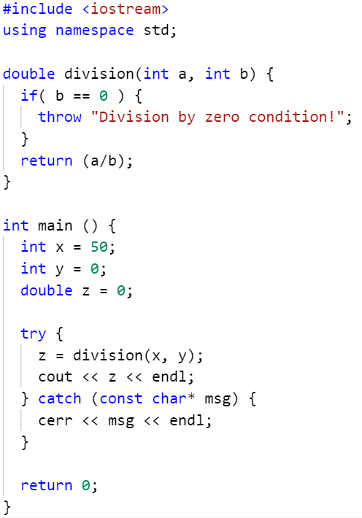

Protected code is inside a try / catch
https://repl.it/@JohnGlazebrook/try-catch-throw-exception

Slide 4
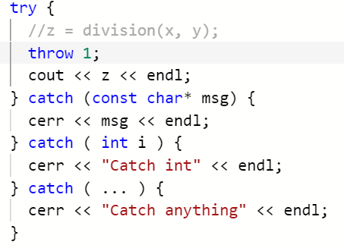


Slide 5
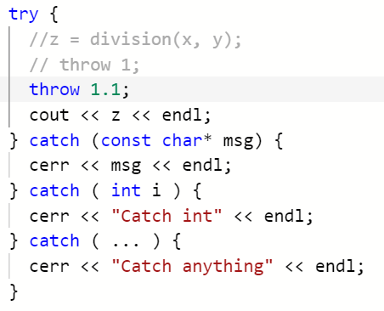


Slide 6
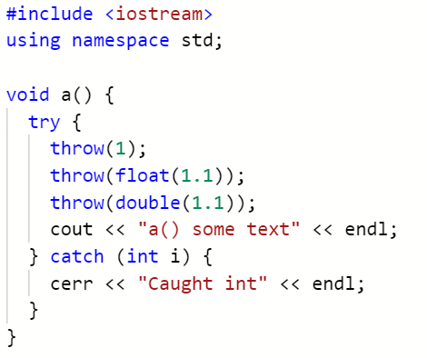
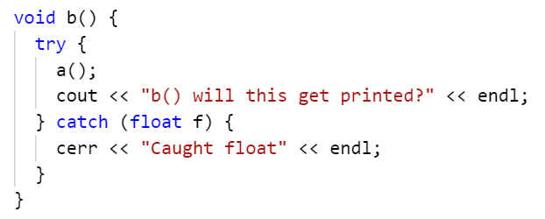
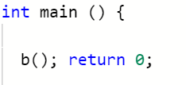

Slide 7


Slide 8
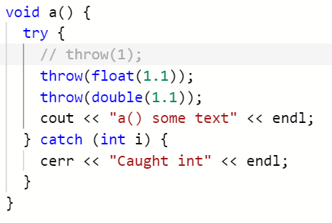

Slide 9


Slide 10
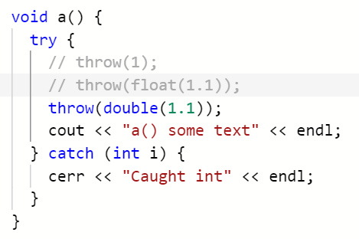

Slide 11


Slide 12
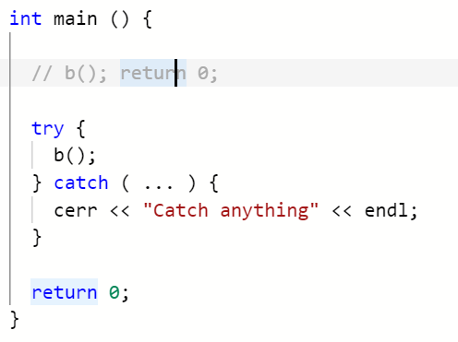


Slide 13
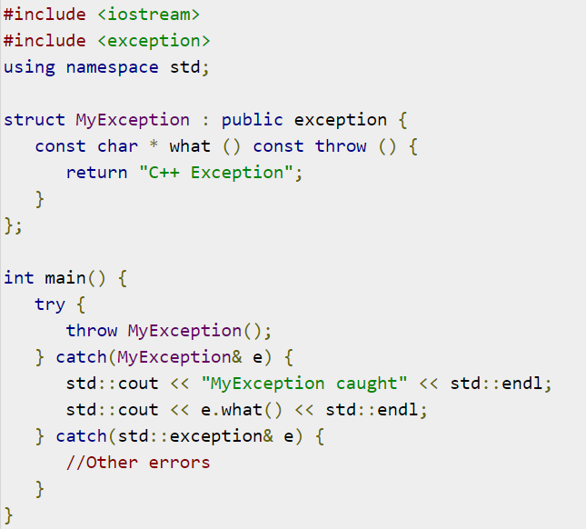
Define your own exceptions

Slide 14
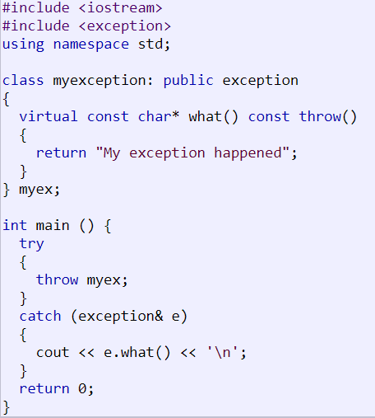
This class has a virtual member function called what that returns a null-terminated character sequence (of type char *) and that can be overwritten in derived classes to contain some sort of description of the exception.

Slide 15
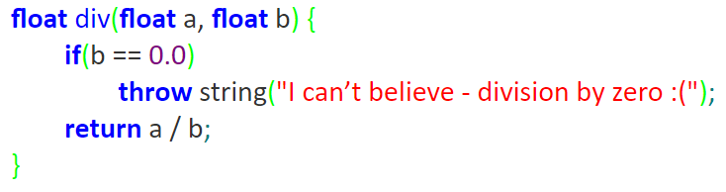

C++ exceptions

Slide 16
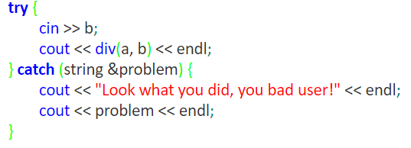

Slide 17
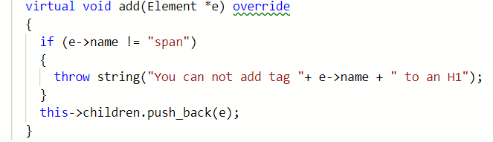

Slide 18
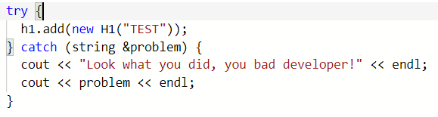

Slide 19

Oo challenges
Hard:
Create a DOM
Inherit from element
to_string()

Slide 20

HTML task list
Document with a title and paragraph of text
Title, three paragraphs of text
Title, three paragraphs, each with a sub title (h2 or h3)
Head with title and meta data, title, paragraphs with text, some of which is bold, italic, bold AND italic.
<link rel="stylesheet" href="my-css-file.css“/>
Lists
Table

Slide 21
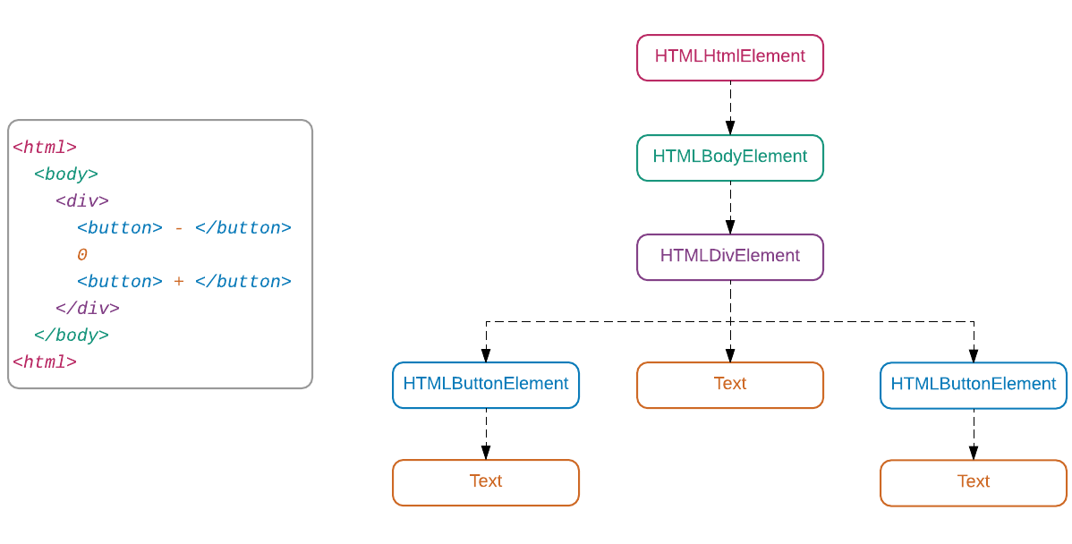

Slide 22
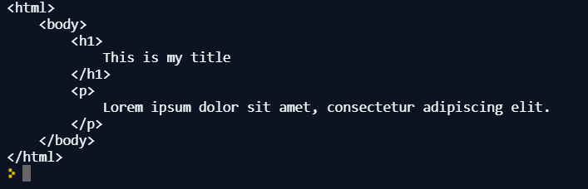

Slide 23
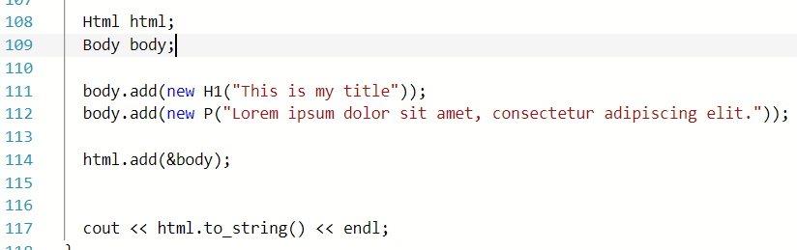

Slide 24
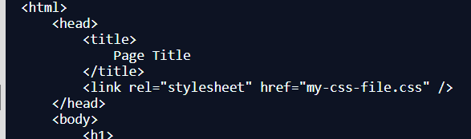

Slide 25
Create a revision list
Go through the spec
What do you need to revise?
Swap with someone
Write some questions

